Slide 1

Rescue Link – Ambulance Dispatch And Tracking
Name: Y. Charan Sai(2520030173)
G.B Vedaditya()
Guide Name: Dr. NirmalaJyothi
Section: 6

Slide 2
Problem Statement
Emergency response services often face challenges in managing ambulance operations efficiently. Manual allocation of ambulances and crew members can lead to delays, poor coordination, and difficulty in tracking emergency incidents. Additionally, the lack of a centralized system makes it harder to monitor vehicle availability, manage emergency requests, and maintain incident records. These issues can negatively impact response times during critical situations. Therefore, there is a need for a centralized Ambulance Dispatch & Tracking System that can efficiently manage ambulance allocation, crew assignments, incident tracking, and real-time status monitoring to improve emergency healthcare services.

Slide 3
Proposed Solution
To overcome the limitations of manual ambulance management, Rescue Link – Ambulance Dispatch & Tracking System is proposed as a centralized web-based platform. The system enables emergency operators to quickly register incidents, allocate available ambulances, assign medical crews, and monitor the progress of emergency responses in real time. It also maintains detailed incident records, fleet information, and crew assignments through an interactive dashboard. By automating key dispatch operations, the system improves coordination, reduces response delays, and enhances the overall efficiency of emergency medical services.

Slide 4
Technologies used
React.js
LocalStorage
Bootstrap
Html
JavaScript
Routers

Slide 5
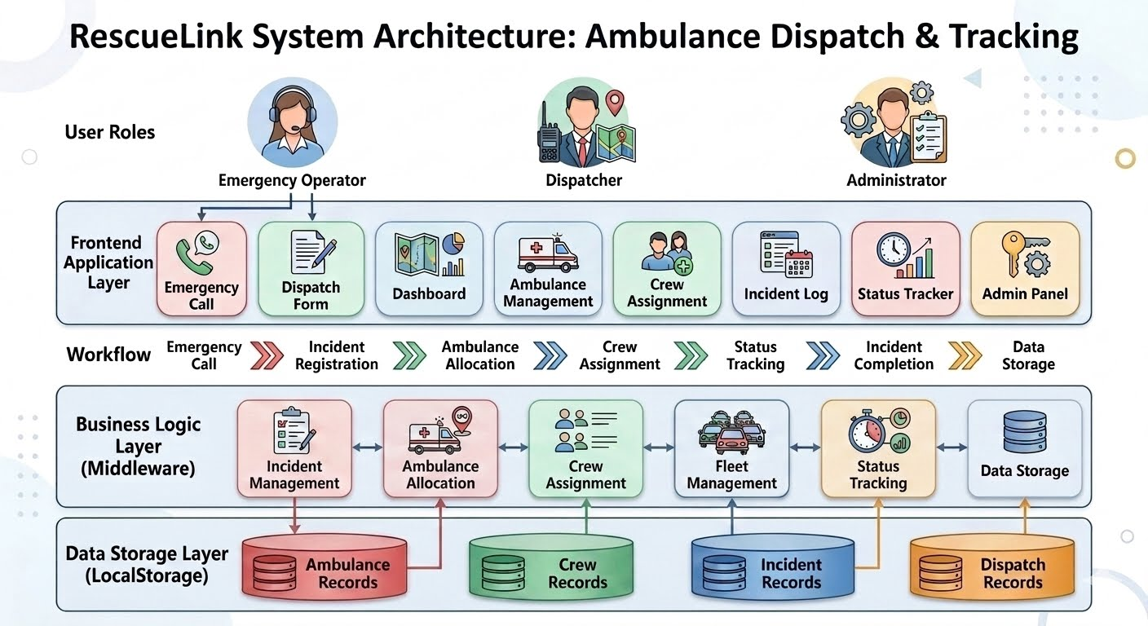
System Architecture

Slide 6
Modules Implemented
Dashboard-Shows active , completed incidents and provides quick system overview
Dispatch Form-Registers emergency incidents
Ambulance Management-Maintains ambulance records and Tracks Availability
Crew Assignment-Assigns drivers and paramedics
Status Tracker-Updates emergency response stages

Slide 7
Key Features
Emergency Incident Registration• Ambulance Allocation
Crew Assignment
Real-Time Status Tracking
Fleet Management
Incident Record Maintenance
Dashboard Monitoring
Local Storage Data Persistence

Slide 8
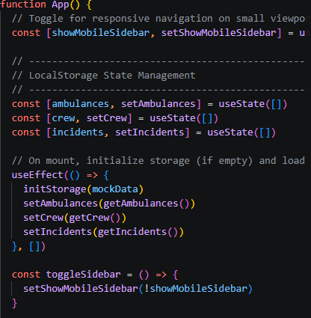
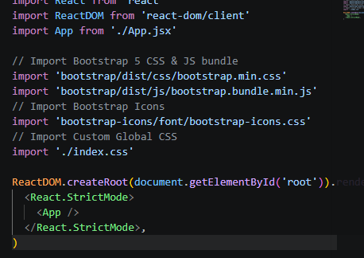
Code Screenshots

Slide 9
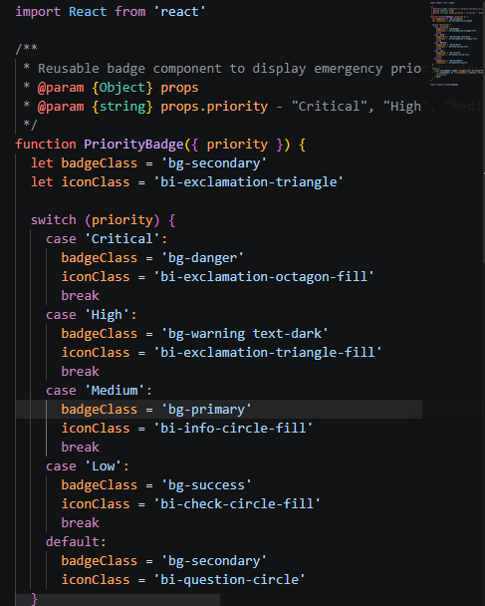
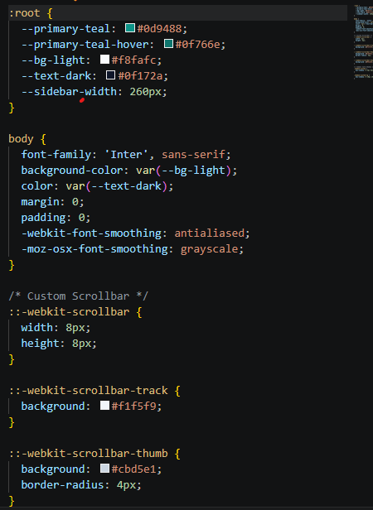

Slide 10
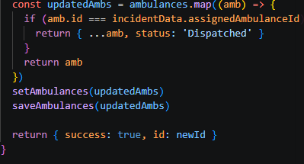
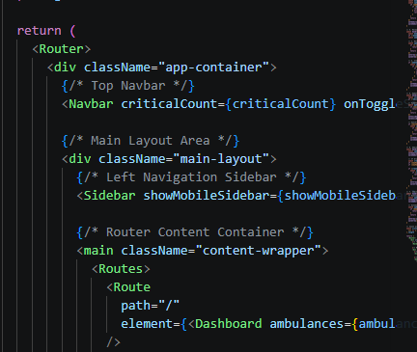

Slide 11
Conclusion
RescueLink – Ambulance Dispatch & Tracking System successfully provides a centralized platform for managing emergency response operations. The system streamlines ambulance allocation, crew assignment, incident tracking, and status monitoring through an intuitive and user-friendly interface. By integrating multiple management modules into a single application, Rescue Link improves operational efficiency, reduces response delays, and ensures better coordination during emergencies. The project demonstrates the effective use of React.js, Bootstrap, and Local Storage in developing a practical healthcare management solution.

